Slide 1
Artificial Intelligence for Health Metricians, Week 5: Decision Trees
Abraham D Flaxman
Feb 2, 2015

Slide 2
Any questions?

Slide 3

Special Room on Wednesday – WRF eSci

Slide 4
Implementations: Real ML Schemes
This is the midpoint of a quarter, and it is when we can start going in depth, method by method.
Class 1: Building regression trees
Class 2: Building classification trees, pruning
Notes:
Starting with decision trees. DM focuses on pruning methods, while ISL focuses on ensembles of trees. I’m saving ensembles for later, so the focus here is on trees, greedy construction, and pruning

Slide 5
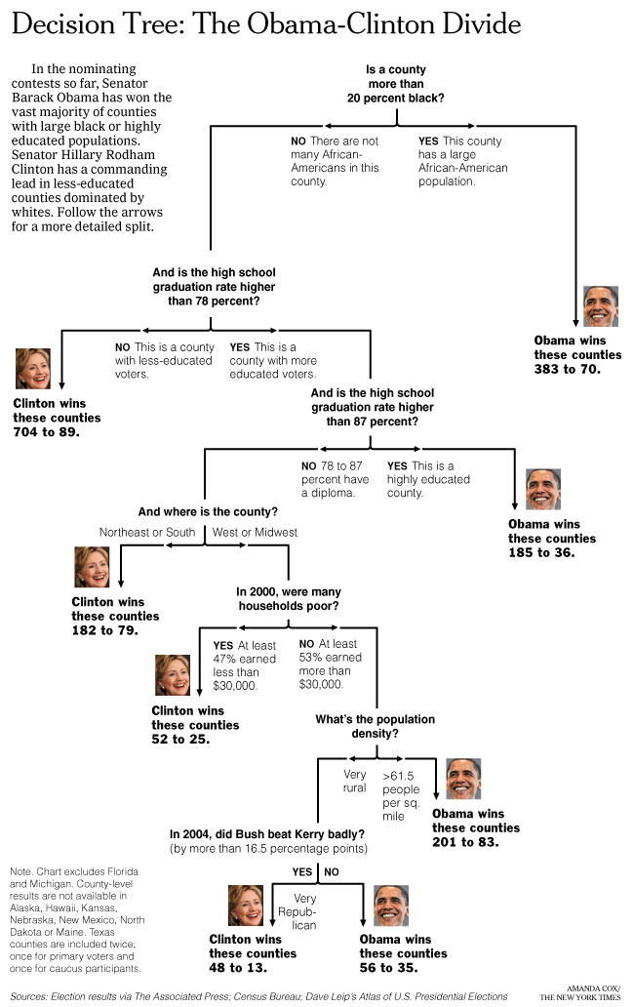
Week 5
Decision Trees

Slide 6
Before, during, and after this week
Before this week: Read (DM 6.1, ISL 8.1)
During classes: Learn how to find the best split in a data set, learn how to iterate this to construct a greedy tree, learn how to prune a tree, learn how to use cross-validation to decide if pruning the tree is worthwhile.
Outside of classes:
Read chapters (DM 6.4, ISM 9), finish Tree exercise, do 10+10 brainstorm for class project

Slide 7
10+10 brainstorm exercise
Write or sketch at least 10 different ideas of what to do for your class project;
Pick the one that seems most interesting, and write/sketch 10 different approaches you could take with it.
The results will be at least 20 ideas that you can pick from to start your project.

Slide 8
10+10 brainstorm exercise
It can help to focus on a particular substantive question, region, or dataset.

Slide 9
10+10 brainstorm exercise
“the best way to have a good idea is to have lots of ideas” - Linus Pauling

Slide 10
Lecture 5a Outline
Homework solutions
Tree-based classification and regression
Exercise 5: the details of decision trees

Slide 11
Any (more) questions?

Slide 12
Lecture 5a Outline
Homework solutions
Tree-based classification and regression
Exercise 5: the details of decision trees

Slide 13
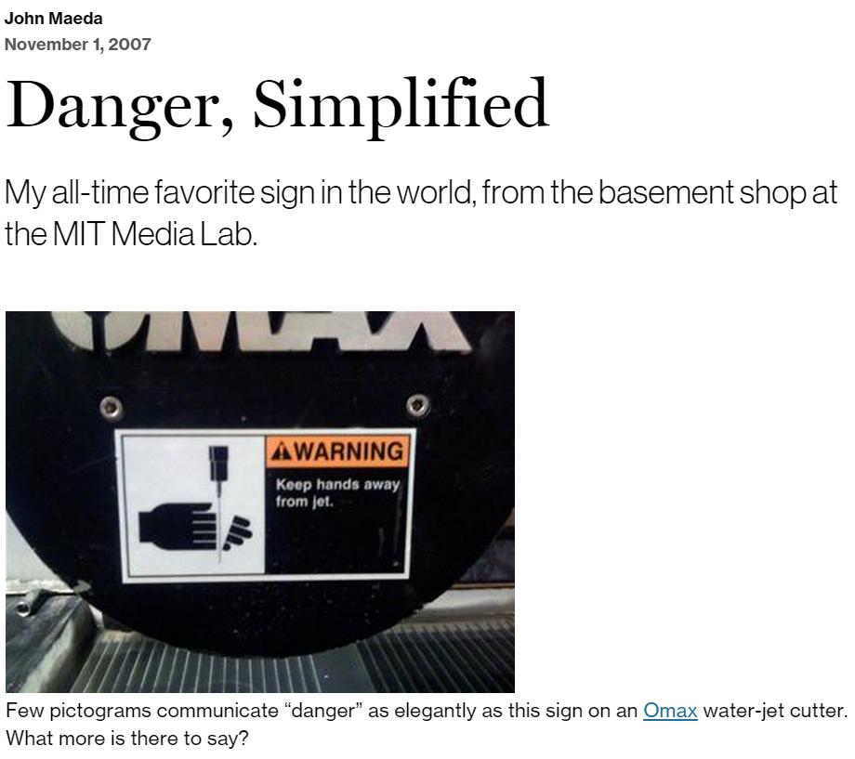
Homework Solutions

Slide 14

Shorter-than-usual distraction
https://www.youtube.com/watch?v=sb_8pQ5lLQs

Slide 15
Lecture 5a Outline
Homework solutions
Tree-based classification and regression
Exercise 5: the details of decision trees

Slide 16
Decision Trees
Tree-based classification and regression
Recursive Partitioning

Slide 17

Ross Quinlan (First CS PhD from UW, 1968)
ID3
C4.5
C5.0

Slide 18
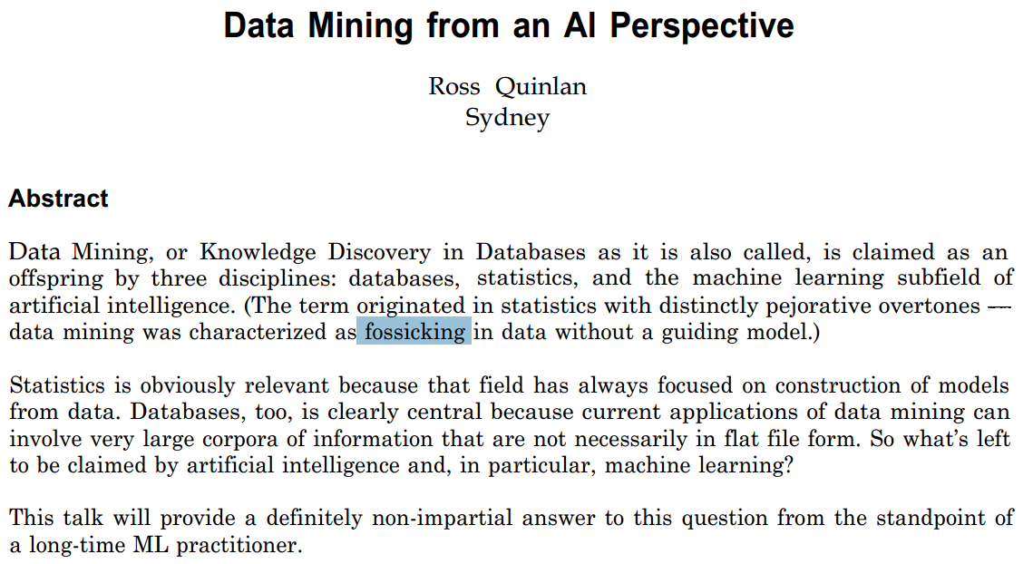
Notes:
http://ieeexplore.ieee.org/stamp/stamp.jsp?tp=&arnumber=754923

Slide 19
Representing Trees

Slide 20
Measuring Split Quality

Slide 21
Building Trees (Recursion)

Slide 22
Bounding Tree Depth

Slide 23
Bounding Minimum Node Size

Slide 24
Pruning

Slide 25
Lecture 5a Outline
Homework solutions
Tree-based classification and regression
Exercise 5: the details of decision trees

